Slide 1


Spatial Analysis in R: An introduction to data manipulation, spatial data analysis and statistical modeling Optional lecture Spatial Dependency - Autocorrelation and Point Pattern Analysis (PPA)
Jeffrey S. Evans, Ph.D.,
Senior Landscape Ecologist & Biometrician
The Nature Conservancy | Protected Lands Science
Visiting Professor | University of Wyoming | Zoology & Physiology
Laramie, WY | jeffrey_evans@tnc.org | (970) 672-6766

Slide 2
Autocorrelation

Slide 3
Tobler’s First Law of Geography
“Things closer in space tend to be more similar than things further apart”

Slide 4
Spatial Autocorrelation
Spatial Autocorrelation – correlation of a variable
with itself through space.
If there is any systematic pattern in the spatial distribution of a variable, it is said to be spatially autocorrelated
If nearby or neighboring areas are more alike, this is positive spatial autocorrelation
Negative autocorrelation describes patterns in which neighboring areas are unlike
Random patterns exhibit no spatial autocorrelation

Slide 5
Why spatial autocorrelation is important?
Most statistics are based on the assumption that the values of observations in each sample are independent of one another
Positive spatial autocorrelation may violate this, if the samples were taken from nearby areas
Goals of spatial autocorrelation
Measure the strength of spatial autocorrelation in a variable
Test the assumption of independence or randomness

Slide 6
Spatial Autocorrelation
Spatial Autocorrelation is, conceptually as well as empirically, the two-dimensional equivalent of redundancy (can be perceived as pseudo-replication)
It measures the extent to which the occurrence of an event in an areal unit constrains, or makes more probable, the occurrence of an event in a neighboring areal unit.

Slide 7
Spatial Autocorrelation
Non-spatial independence suggests many statistical tools and inferences are inappropriate.
Correlation coefficients or ordinary least squares regressions (OLS) to predict a consequence assumes that the observations have been selected randomly.
If the observations, however, are spatially clustered in some way, the estimates obtained from the correlation coefficient or OLS estimator will be biased and overly precise.
They are biased because the areas with higher concentration of events will have a greater impact on the model estimate and they will overestimate precision because, since events tend to be concentrated, there are actually fewer number of independent observations than are being assumed.

Slide 8
Spatial autocorrelation is an impediment to the
application of standard statistics
t-tests
Correlation
Regression
ANOVA
If data is spatially autocorrelated the
assumptions of independent observations and
error is violated.
The degrees-of-freedom is effectively much less
in the presence of spatial autocorrelation.

Slide 9
Measures
Moran’s I, Geary’s C, Getis-Ord G, Join-Count Statistics
Autocorrelation Structure
Positive – close things have similar values
Negative – close things have dissimilar values
Zero – close things have values with no predictable relation

Slide 10
Spatial Weights Matrix
W_{ij} is a contiguity matrix
If zone j is adjacent to zone i, the interaction receives a weight of 1
Another option is to make W_{ij} a distance-based weight which is the inverse distance between locations I and j (1/d_{ij})
Compares the sum of the cross-products of values at different locations, two at a time weighted by the inverse of the distance between the locations
When autocorrelation is high, the coefficient is high
A high I value indicates positive autocorrelation
Problems with weights
Potential for distorted I value.
W_{ij} is normalized by:

Slide 11
Nominal Data
Joins-Count Statistic
Interval/Ratio Data
Moran's I
Geary's C
Getis-Ord G
These are used when we want to undertake a statistical test of spatial autocorrelation. However, the semi-variogram, similar to Geary's C, is also used to measure spatial autocorrelation in order to model spatial dependence.
For any mapped variable (attribute) Z, spatial autocorrelation measures the
degree to which values neighboring Z are similar or dissimilar.
If values close to each other are similar we say the mapped pattern exhibits positive spatial autocorrelation
If values close to each other are dissimilar (e.g., high-low) then we say the mapped pattern exhibits negative spatial autocorrelation.

Slide 12
If positive autocorrelation exists then describing
the autocorrelation structure is of primary
importance and is of two types
First-order spatial variation: values of observations vary according to changes in the underlying local environment across a study region. Large-scale trends.
Second-order spatial variation: values between observations vary due to local interaction effects. Local hot-spots that may or may not be superimposed on large-scale trends.

Slide 13
Joins-Count Statistic
The Join-Count (JC) statistic is
used with nominal data to
assess spatial autocorrelation.
Data is coded as 1's or 0's (or any number of nominal classes).
1's are called Whites (W) and 0's are called Blacks (B).
Statistic assesses how often
There are Black-Black (BB) adjacencies.
There are White-White (WW) adjacencies
There are Black-White/White-Black (BW/WB) adjacencies.
Where B and W represent colors
of each unit. K is the total number of
joins present in the dataset being
tested.

Slide 14
Positive spatial autocorrelation
when similar nominal values
are found next to each other.
Negative spatial autocorrelation
is when we find dissimilar
nominal values next to each
other more often than not.
Lack of (or zero) spatial
autocorrelation means that the
neighboring nominal values are
neither similar or dissimilar.

Slide 15
Joins-Count Statistic
We cannot conclude that the number of
BB or WW exhibits positive spatial
autocorrelation until we have shown that
the observed number of joins is different
from a random pattern.
The generation of the random pattern is
done either using
Non-free sampling – permutation, the probability of a cell being B or W is dependant on the total number of B and W values present.
Free-sampling – normal sampling and the probability of a cell being either black or white is not dependant on the number of B and W cells present.
Here, k is the number of total
number of joins on the map
(row-sum of adjacency matrix)
and p is the probability of a cell
being coded either B or W.

Slide 16
Moran's I examines the product of the
differences of adjacent values from the overall
mean of the dataset.
Range: -1 to 1
Expected value under randomization is -1/(n-1) ~ 0
This numerator is a covariance term.
Values from 0 to 1 indicate positive autocorrelation.
If both values are above or below the mean then the numerator is positive – positive autocorrelation
Values between -1 to 0 indicate negative autocorrelation
If one is above and the other below then the numerator is negative – negative autocorrelation.
The weights matrix determines from a set of spatial locations, which values are considered and which are not in the calculation of I.
With strange weights matrices (i.e. higher order neighbors), values may fall outside the range of -1 to 1.
Moran's I
Where N is the number of cases
X_{i} is the value at a particular
location
X_{j} is the value at another location
X is the mean of the variable
W_{ij} is a weight applied to the
comparison between location I and
location j (weighting matrix)

Slide 17
Moran's I: Significance Test
Given that you can calculate the
variance in order to get the standard
deviation of I, then the z-value
obtained using the equation on the
right can be referenced to a z-table to
determine the level of significance
this is no different than any standard
statistic.
Observed value of I for the dataset being analyzed

Slide 18
Geary’s C
Similar to Moran’s I (Geary, 1954)
Interaction is not the cross-product of the deviations from the mean, but the deviations in intensities of each observation location with one another

Slide 19
Geary’s C
Value typically range between 0 and 2
If value of any one zone are spatially unrelated to any other zone, the expected value of C will be 1
Values less than 1 (between 1 and 2) indicate negative spatial autocorrelation
Inversely related to Moran’s I
Does not provide identical inference because it emphasizes the differences in values between pairs of observations, rather than the covariation between the pairs.
Moran’s I gives a more global indicator, whereas the Geary coefficient is more sensitive to differences in small neighborhoods.

Slide 20
Geary's C
Geary's C measures the absolute
squared difference between
values of a adjacent variables.
Range: 0 to 2.
Expected value under randomization is 1.
Positive spatial autocorrelation is found with values ranging from 0 to less than 1
If adjacent values are very similar, the numerator tends towards zero.
Negative spatial autocorrelation is found for values between 1 and 2.
However, values can be found greater than 2 on occasion (Griffith, 1987)
Where W represents the spatial
weights matrix and x represents
the value of the variable being
considered.

Slide 21
Getis-Ord Global G
The G statistic measures the degree
to which large or small values of a
variable cluster.
Range: 0 to large positive numbers
Only uses binary connectivity matrices.
Moran’s I and Geary’s C will see only similar values as positive spatial autocorrelation.
High values and low values that are close together will show positive SA.
The G statistic will tell us whether it is large or small values that lead to the spatial autocorrelation.
Hotspots vs. coldspots
Most often presented as a z-value rather than as the statistic itself.
Positive z-values indicate high-values giving rise to autocorrelation.
Negative z-values indicate low values giving rise to autocorrelation.
Where W represents the spatial weights
matrix and x represents the value of the
variable being considered.

Slide 22
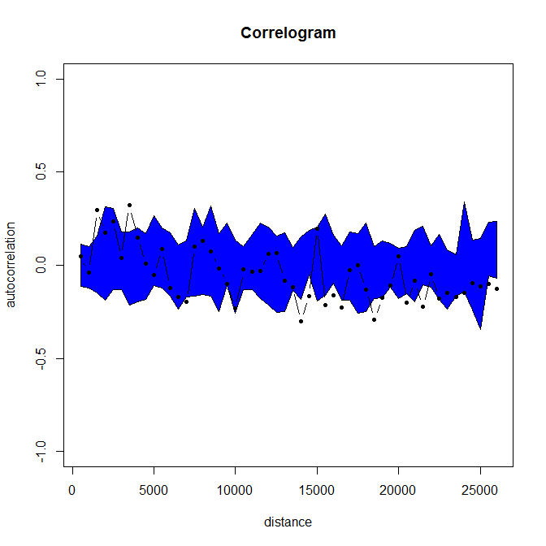
Correlogram
The correlogram allows us to look at how spatial autocorrelation behaves as we consider more and more distant neighbors in the calculation of I, C or G.
Helps us to understand the range of similarity in a particular geographic dataset.
Here we must understand the concept of higher-order neighbors.
The correlogram ultimately allows us to determine the natural scale of similarity of the variable of interest.
0.6
0.4
0.2
Moran's I
0.0
-0.2
-0.4
1
2
3
4
5
lags

Slide 23
Notes on the Correlogram
When you create a correlogram, you are undertaking multiple tests on the same dataset. By chance alone, you might expect 1/20 of those tests to yield significant values of I, even when there is no global spatial autocorrelation present.
As such, before interpreting the correlogram, you should ensure that at least one of the statistics within the correlogram is significant at the Bonferroni corrected level of 0.05/ntests.
That is to say, if you have 5 lags, then you should ensure that at least one I value in the correlogram has a p-value less than z = 0.05/5 or p=0.01.
Failure to take this into account will result in too often rejecting the null hypothesis and inferring spatial structure when in fact there is really none.

Slide 24
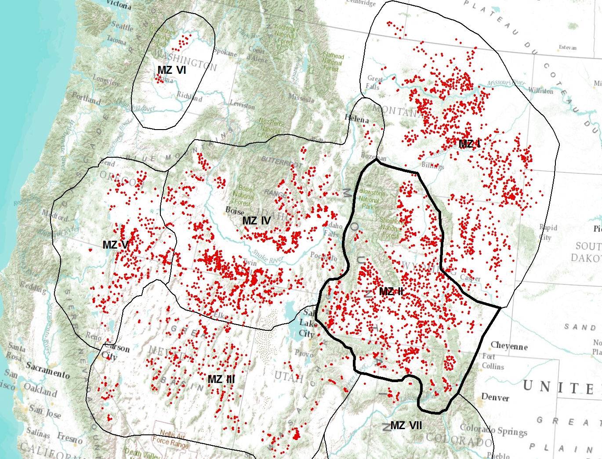
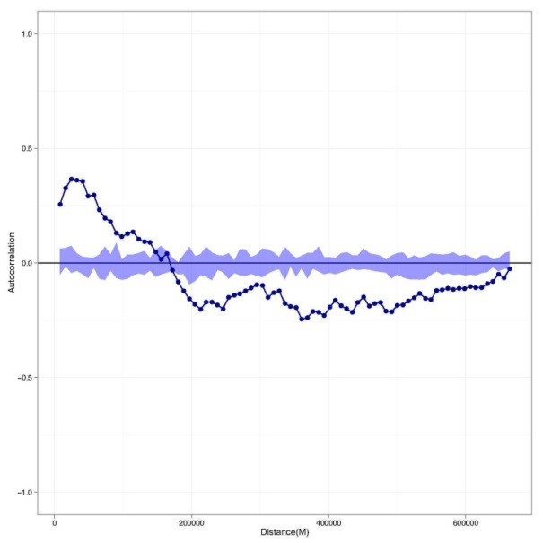
Spatial variation in sage grouse

Slide 25
Point Pattern Analysis

Slide 26
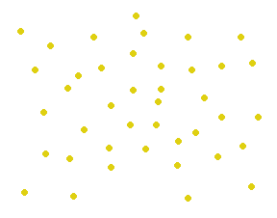

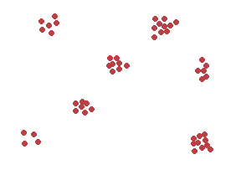
A point pattern is either:
Random
Systematic (regular)
Clustered
Random
Hypothesis Testing
To test whether the observed pattern is a
likely realization of a hypothesized process
means creating a NULL hypothesis:
H_{o}: The spatial point pattern is no different from a pattern derived from a CSR process.
H₁: The spatial point pattern is significantly different from that produced by a random process.
Systematic/Regular
Clustered

Slide 27
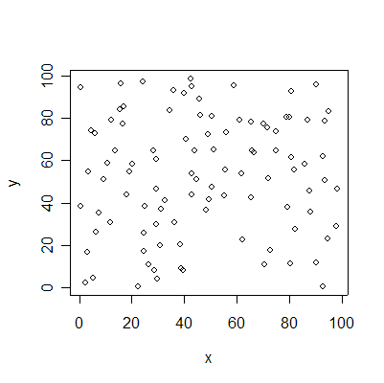
Pattern Description
Standard Distance
Standard Deviation
Ellipse
Point Density
Quadrat Counts
Kernel Density
Point Separation
Nearest Neighbor techniques
1-st order
NN distance
G-hat
F-hat
2-nd order
K & L-hat

Slide 28
Coordinate values should be in a 2-D planar (Cartesian) system – (Longitude/Latitude are not a distance value so should not be used).
Study region should be objective and not imposed.
The pattern should be a complete enumeration or one-to-one census of all points - not a sample of events.
Event locations must not be approximated – e.g., using centroids of CT’s or any other arbitrary means.

Slide 29
Point Pattern Terminology
Point: An arbitrary location within the study region that is not part of the original observed set of locations.
Event: An observed location within the study region.

Slide 30
Most standard statistical techniques have significant problems when we try to apply them to spatial data.
Geospatial referencing allows the incorporation of distance, adjacency, interaction and neighborhood concepts into analysis.
Is there a relation between data attributes and their spatial locations?

Slide 31
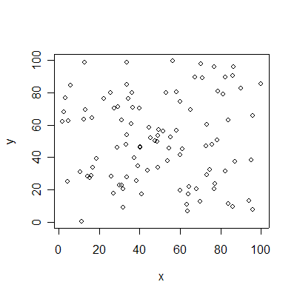
Complete Spatial Randomness (CSR)
Properties of the CSR
Same process every time but different outcome.
Random describes the process of locating the points but NOT the pattern
WRONG: The pattern is a random pattern
CORRECT: The pattern conforms to a random process of x,y coordinate selection
Sometimes there are obvious clusters produced by a random process.
This does not mean that a similar geographically produced pattern is a chance occurrence and there is usually a reason why something exists where it exists.

Slide 32
Pattern Description
Mean Center
Standard Distance

Slide 33
Density Based Measures
Characterize pattern in terms of first-order properties
Variation in intensity, (lambda), across study region.
Therefore, lambda is sensitive to size or area in which intensity or density is measured.
n is the number of
events in pattern S
within A and a is the
area of A.

Slide 34
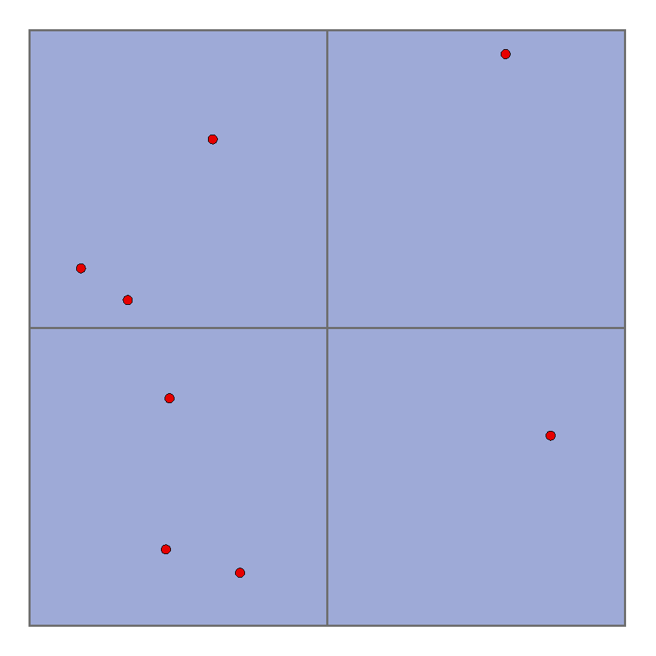
QUADRAT ANALYSIS
Consider the 4 quadrats at the left and the 8 points that were placed within the entire region using a CSR process.
Each was placed with equal probability and as such each quadrat has an equal chance of receiving a point.
The positioning of any point was independent of the positioning of any other point.

Slide 35
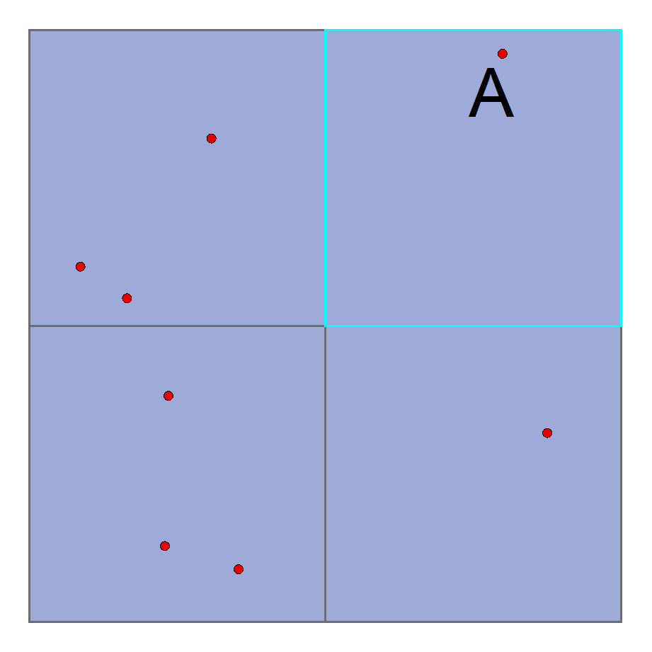
The probability of one event
occurring in a particular quadrat
is equal to the fraction of the
study area that the quadrat
represents.
Here we say that the probability of
A occurring in one quadrat is P(A).

Slide 36
Density Based Measures: Quadrat Counting
A
A) Square tessellation – exhaustive census
Most Common
B) Random Sampling
Common in field studies
Can miss events in the pattern
Questions of size and n.
B

Slide 37
Density Based Measures: Quadrat Counting
Square Tessellation
Choice of origin
Quadrat orientation
Quadrat Size
All above affect
observed frequency
distribution
1.0
0.8
0.6
y
0.4
0.2
0.0
0.0
0.2
0.4
0.6
0.8
1.0
x

Slide 38
Density Based Measures: Kernel Based Approaches
Kernel-density estimation (KDE)
Pattern has a density that is created by measuring the number of events per unit area defined at regular intervals within the study area.
We then have the intensity or density at point p being measured.
The Naïve method uses a moving circle around a grid imposed on the study area
Measures local intensity and
is a good check for 1st order
intensity or 1st order stationarity
(e.g., no global trends in intensity
across the study region).

Slide 40
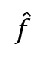
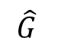
G-hat relates how close events
are from each other.
Shallow or slow rise to maximum means regularity.
Quick rise to maximum means clustering.
$$\hat{G}$$
distance
F-hat relates how far events are
from randomly selected points.
Shallow or slow rise to maximum means clustering
Quick rise to maximum means regularity.
$$\hat{f}$$
distance

Slide 41
Khat is easy to calculate when edge effects are
not considered.
Provides a test of randomness at every distance d (scale), potentially up to the size of the study area.
Designed to look for second order trends rather than just the general 1st order variation across the study region.
Where S is the set of events within
a circle of radius d surrounding
event s_{i} and n is the number of
events and lambda the intensity.

Slide 42
K-hat is calculated by for each event by:
Placing a circle of radius d on each event.
Counting the number of points within d
Taking the total number of points within d across all events and dividing by n times the intensity.
This is repeated for any number of
radii, d, for example, 1 unit, 2, units,
3 units, etc…

Slide 43
Expected Value of Khat – theoretically under CSR
The expected value for Khat is equal to the pattern Intensity multiplied by the area of the given radius.
This is related to the concept of Monte-Carlo integration:
That in a CSR the number of points falling within a given region is equal to the proportion of the study area taken up by the region.
d

Slide 44
Cross-K: Bivariate Point Patterns Spatial Interaction
"Cross-K" function for the test of bivariate point pattern independence.
The only difference between this test and Khat is that K₁₂(d) counts the number of events in the second pattern within radius d of the first pattern.
Like Khat, if the two events are independent than K₁₂(d) is the same as comparing a CSR process to a given event pattern.
K₁₂(d) is tested via Monte-Carlo Simulation .
Again, as with Khat, Lhat is used for such simulations.
Where S₁ is the number of events in
the first pattern, pattern 1, within
radius d around an event in pattern
2 s_{2i} . All other terms are as before.

Slide 45
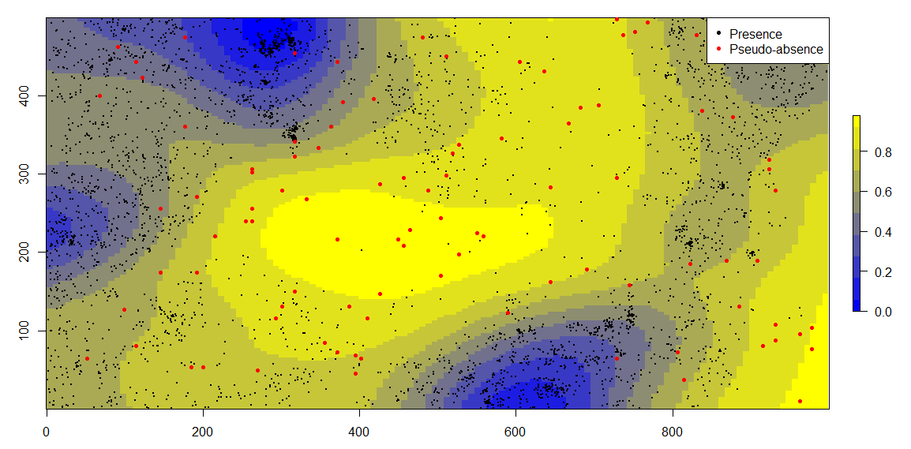
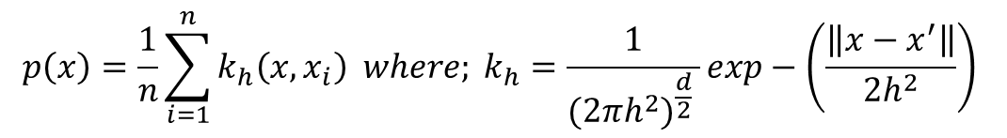
Density, kernel density estimates (KDE) and intensity (point process models)
Deriving the null class in the binomial distribution
Probability sample weights base on spatial process of species observations using an adaptive Isotropic density estimate
Isotropic Kernel Density Estimate
$$p\left(x\right)=\frac{1}{n}\sum_{i=1}^{n}{k_{h}\left(x,x_{i}\right) where; k_{h}=\frac{1}{(2πh^{2})^{\frac{d}{2}} }exp−\left(\frac{\left\|x−x^{′}\right\|}{2h^{2}}\right) }$$

Slide 46
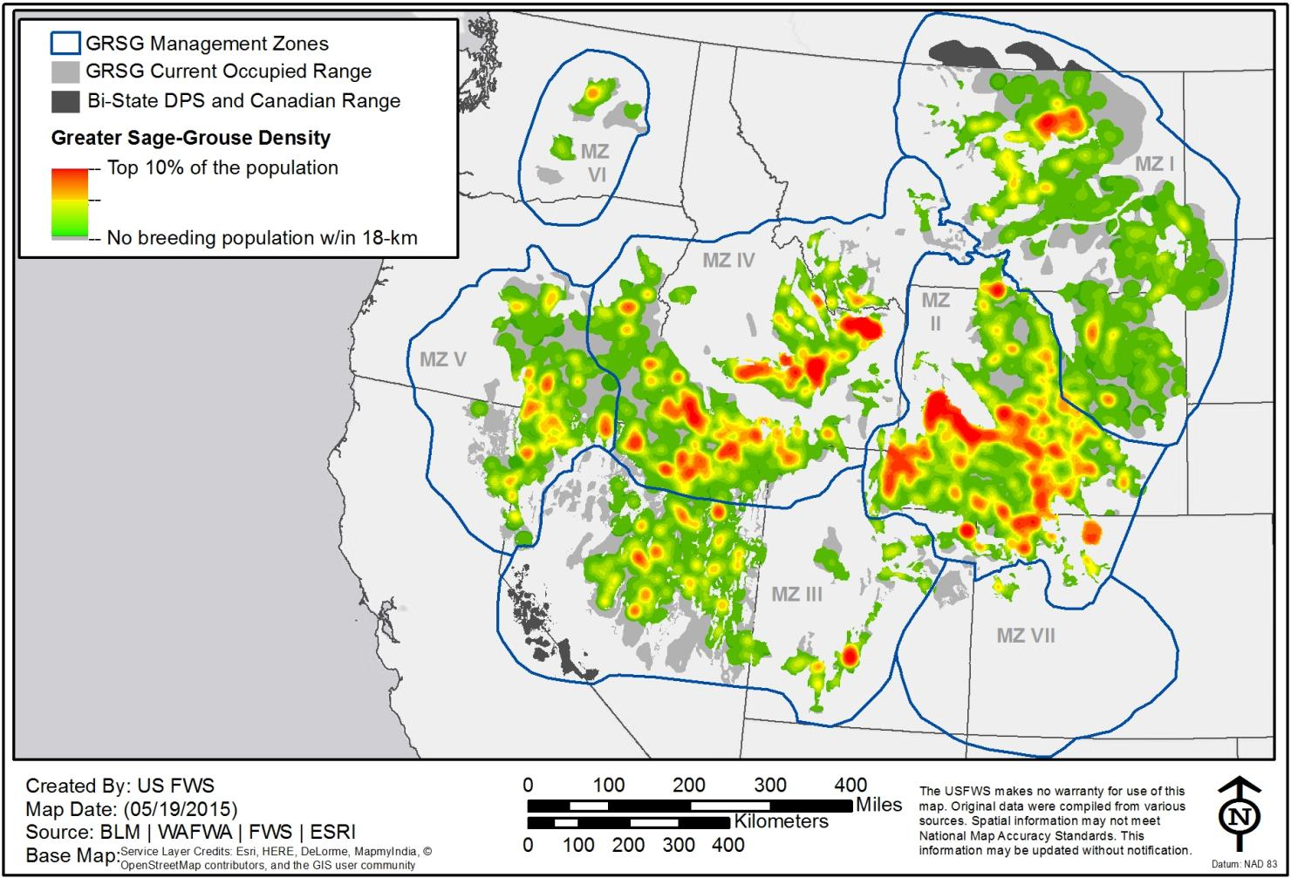
Ecological niche volume
p | resource selection probability
1st and 2nd order abundance volume
Relative Population Index Estimate
Z(x|y) = ∑[(x_{i} y_{i}) / (X a_{i})]
Doherty and Evans (2016) Importance of regional variation in conservation planning: a rangewide example of the Greater Sage-Grouse. Ecosphere
Hurlbert, S.H. (1978) The Measurement of Niche Overlap and Some Relatives. Ecology 59(1):67-77

